Slide 1
Chapter 1
Computer Abstractions and Technology
Lesson 2: Understanding Performance

Slide 2
Indeed, the cost-performance ratio of the product will depend most heavily on the implementer, just as ease of use depends most heavily on the architect.
The Mythical Man-Month, Brooks, pg 46

Slide 3
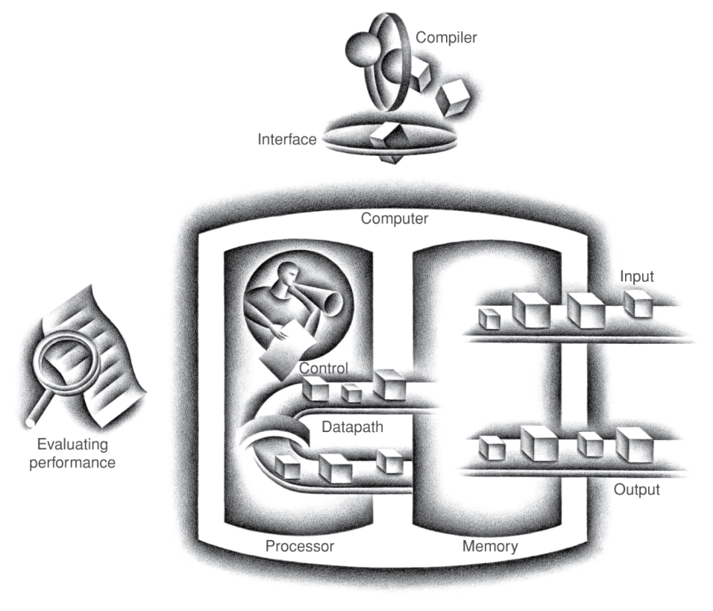
So far…
Progress in computer technology has been revolutionary
The Computer Components
I/O
Mouse, Monitor,
Printer, etc.
Processor
Memory
Volatile main memory
Non Volatile secondary
memory

Slide 4
Performance Metrics
Purchasing perspective
given a collection of machines, which has the
best performance?
least cost?
best cost/performance?
Design perspective
faced with design options, which has the
best performance improvement?
least cost?
best cost/performance?
Both require
basis for comparison
metric for evaluation
Our goal is to understand what factors in the architecture contribute to overall system performance and the relative importance (and cost) of these factors
Notes:
Or smallest/lightest
Longest battery life
Most reliable/durable (in space)

Slide 5
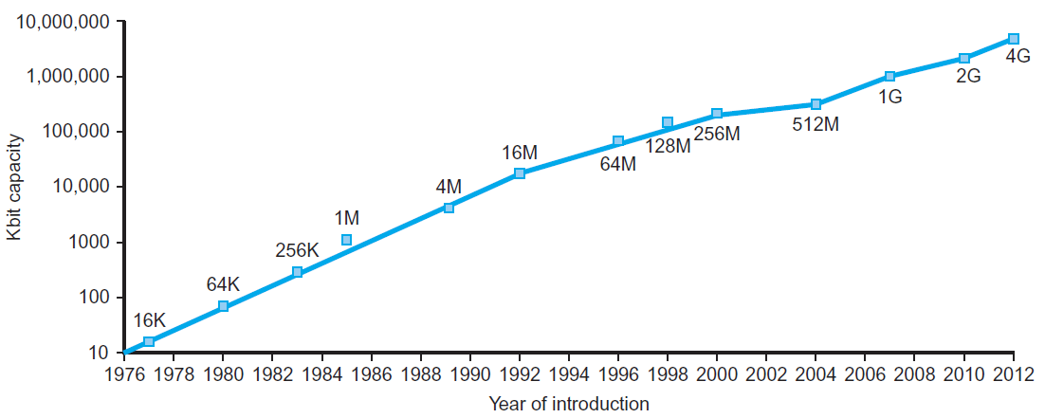
Technology Trends
Electronics technology continues to evolve
Increased capacity and performance
Reduced cost
§1.5 Technologies for Building Processors and Memory
DRAM capacity
Year | Technology | Relative performance/cost
1951 | Vacuum tube | 1
1965 | Transistor | 35
1975 | Integrated circuit (IC) | 900
1995 | Very large scale IC (VLSI) | 2,400,000
2013 | Ultra large scale IC | 250,000,000,000

Slide 6
Defining Performance
§1.4 Performance
Which airplane has the best performance?

Slide 7
Response Time
Response time How long it takes to do a task
The length includes disk access, memory access, I/O activities, operating systems overhead, etc.
Important to individual users but often not good for comparison purposes
Good to determine system performance
It is also called execution time, or elapsed time

Slide 8
Response Time and Throughput
Throughput (also called bandwidth)
Total work done per unit time
e.g., tasks/transactions/… per hour
Important to data center managers
How are response time and throughput affected by
Replacing the processor with a faster version?
Adding more processors?
We’ll focus on response time for now…

Slide 9
Relative Performance
Define Performance = 1/Execution Time
“X is n time faster than Y”
Example: time taken to run a program 10s on A, 15s on B. How much faster is A than B?
Execution Time_{B} / Execution Time_{A} = 15s / 10s = 1.5
So A is 1.5 times faster than B
Notes:
Increasing performance requires decreasing execution time

Slide 10
Another Example
Problem:
machine A runs a program in 20 seconds
machine B runs the same program in 25 seconds
Question: How much faster is A than B?
The performance ratio is:
25/20 = 1.25
i.e. A is 1.25 faster than B
If A is n times faster than B, then
performance_{A} execution_time_{B}
-------------------- = --------------------- = n
performance_{B} execution_time_{A}
Notes:
Increasing performance requires decreasing execution time

Slide 11
Measuring Execution Time
CPU time
the time spent by the CPU to complete his task and doesn't include I/O or time spent running other program
it includes user CPU time and system CPU time
system CPU time - time spent in OS performing tasks on behalf of a program;
user CPU time (also called CPU performance) - time spent by the CPU in a program itself
Different programs are affected differently by CPU and system performance
CPU performance refers to the user CPU time
aka CPU execution time

Slide 12
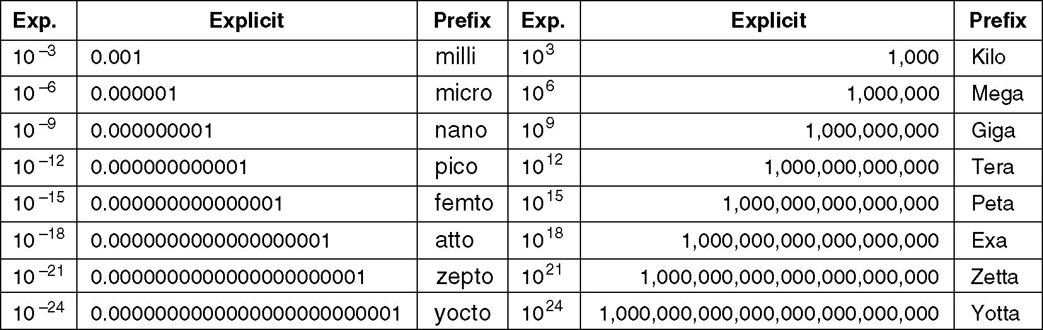
Metric Units
The principal metric prefixes.

Slide 13
CPU Clocking
Operation of digital hardware governed by a constant-rate clock
Clock period
Clock (cycles)
Data transfer and computation
Update state
Clock cycles, also called tick, clock tick, clock, cycles = the discrete time interval in which events take place in the hardware

Slide 14
Definitions and Formulas
Clock period = length of a clock cycle
measured in time units
e.g., 250ps = 0.25ns = 250×10^{–12}s
Clock frequency, also called clock rate = number of cycles per second
measured in Hertz
1 Hz = 1 cycles/sec
kHz (kilohertz, 10³ Hz), MHz (megahertz, 10⁶ Hz), GHz (gigahertz, 10⁹ Hz) and THz (terahertz, 10¹² Hz)
e.g., 4.0GHz = 4000MHz = 4.0×10⁹Hz

Slide 15
CPU Time
CPU execution Time per program, in brief CPU Time
per program
Performance improved by
Reducing number of clock cycles
Increasing clock rate
Hardware designer must often trade-off clock rate against cycle count

Slide 16
CPU Time Example
Computer A has a 2GHz clock. Program P runs in 10s (i.e. takes 10s of CPU time)
We want to design computer B
We aim to run P in 6s of CPU time
We make a faster clock (increase the clock rate) which causes an increase of 1.2 × clock cycles for P on B with respect to (wrt) A
How fast must computer B clock be? (i.e. what is B’s clock rate?)

Slide 17
Performance
A program is made of instructions. The more instructions, the longer is the time required to execute the program.
Each instruction takes a certain amount of time
Some take several clock cycles (take longer time) some take just a few cycles (take a shorter time)
Let us consider an average time per instruction (average clock Cycles Per Instruction)
A formula that expresses the execution time in terms of the instruction number consider multiplying the number of instructions (Instruction Count) for the average time used by an instruction (average clock CPI)

Slide 18
Instruction Count (IC) and Cycles Per Instruction (CPI)
Instruction Count for a program (IC)
Determined by the program, the ISA and the compiler
Average cycles per instruction (CPI)
Determined by the CPU hardware
If different instructions have different CPI
Average CPI affected by instruction mix

Slide 19
Next Time
More on Performance
Power Trend
Integrated Technology
Amdhal’s Law
MIPS
HW 1 is issued

